Slide 1
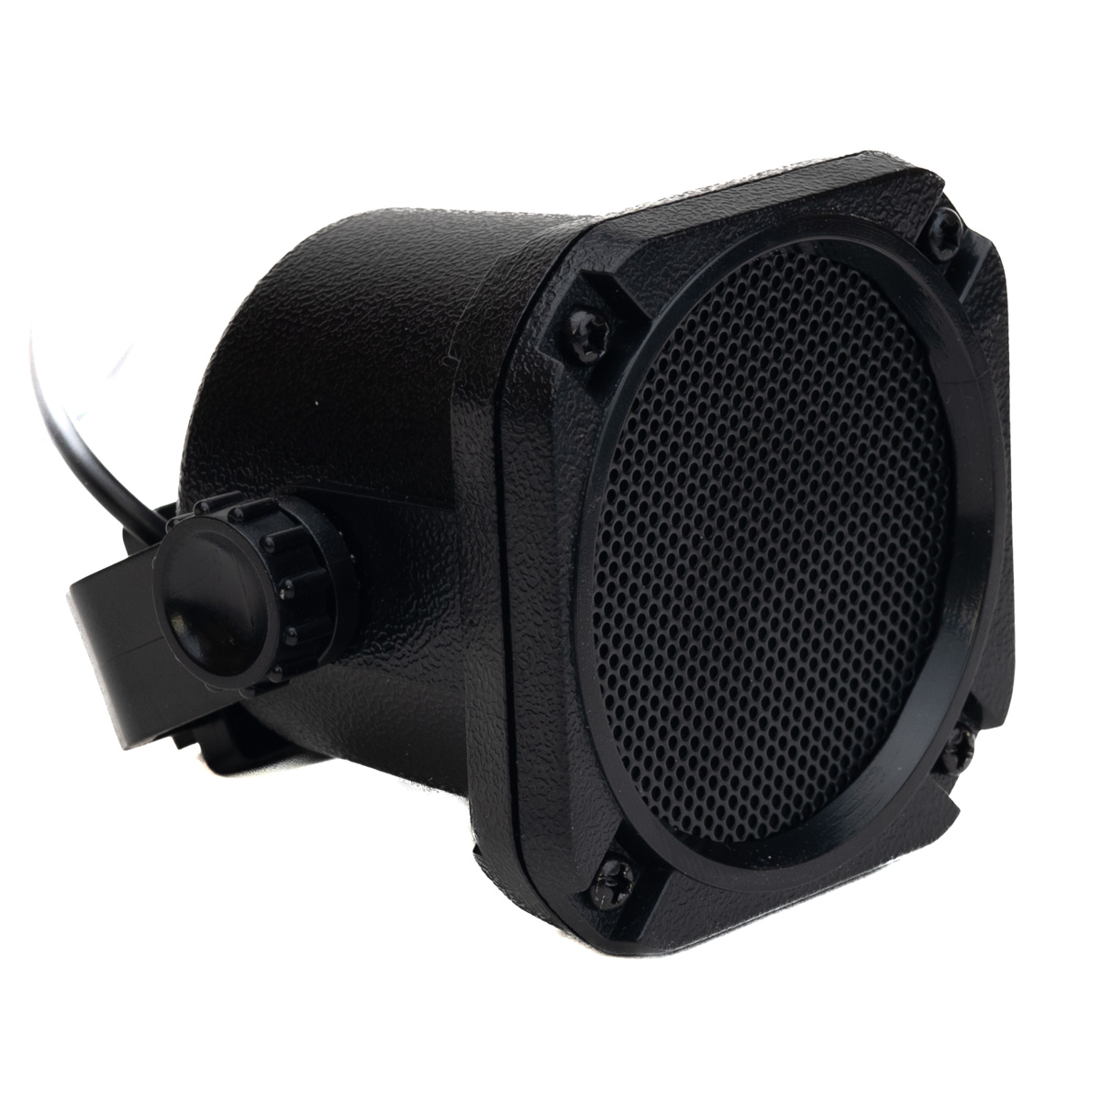
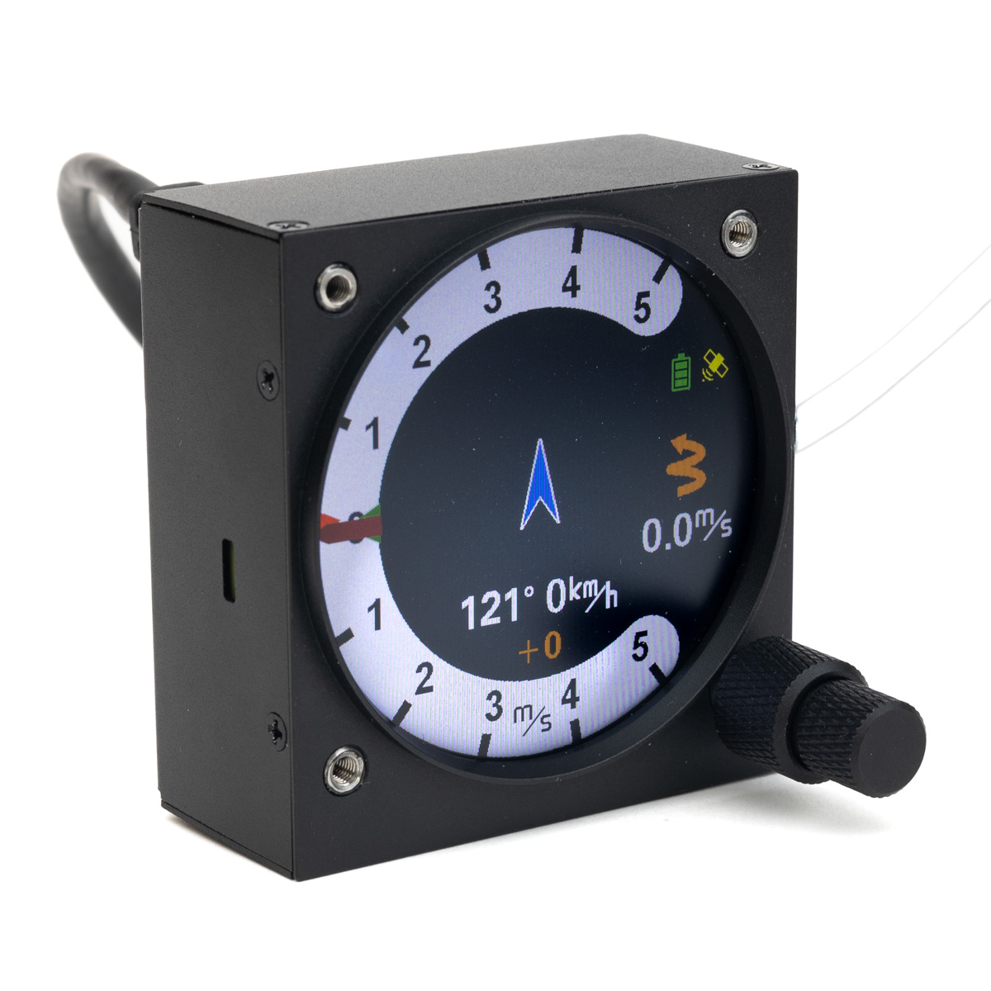
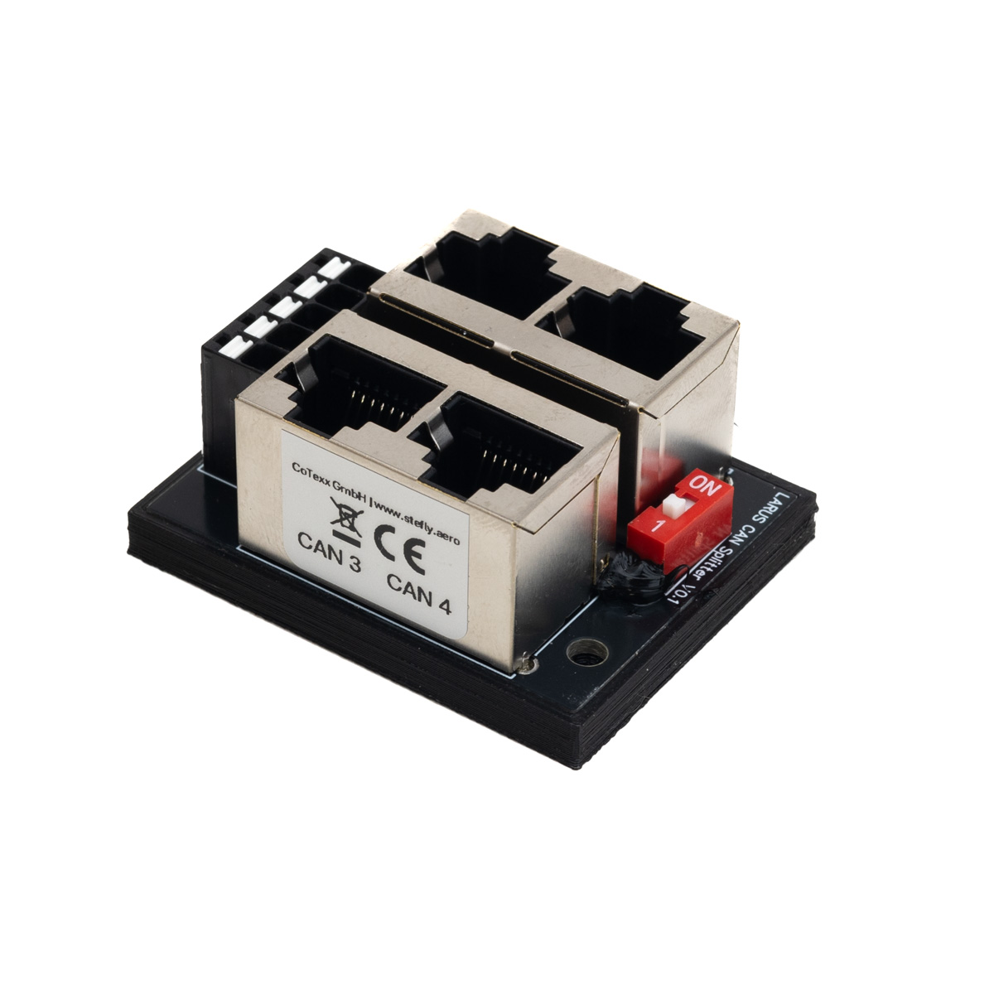

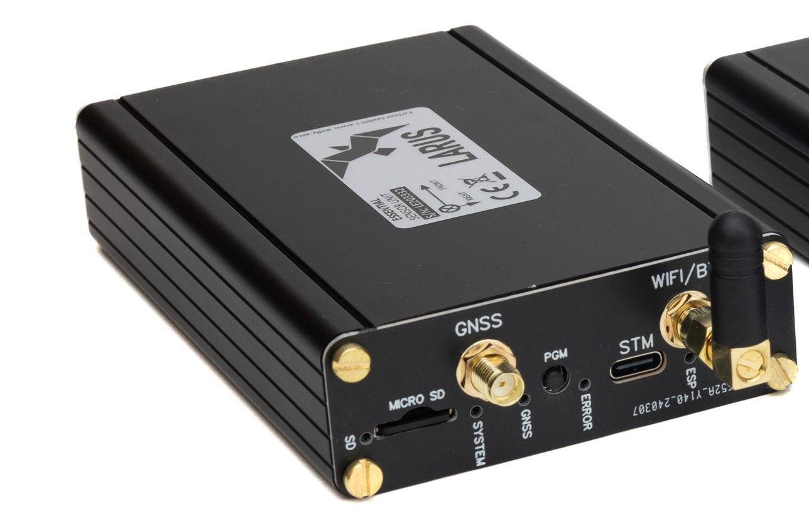
3,5 mm audio jack
1:1 patch cable
1:1 patch cable
CAN port
CAN port
CAN port
CAN port
RS232 port
CAN port
RS232 port
patch cable with RX / TX crossed
patch cable with RX / TX crossed
ttySx
CAN port
ttySx

